Slide 1
Requirements Engineering
Establishing what the customer requires from a software system
what is it
Notes:
Objectives:
To introduce the notion of requirements engineering
To explain why requirements at different levels of detail are needed
To describe how the system requirements document may be organised
To describe the requirements validation process
To explain why requirements evolve during the lifetime of a system

Slide 2
Requirements engineering
The process of establishing the services that the customer requires from a system and the constraints under which it operates and is developed
Requirements may be functional or non-functional
  Functional requirements describe system services or functions
  Non-functional requirements is a constraint on the system or on the development process

Slide 3
What is a requirement?
It may range from a high-level abstract statement of a service or of a system constraint to a detailed mathematical functional specification
This is inevitable as requirements may serve a dual function
  May be the basis for a bid for a contract - therefore must be open to interpretation
  May be the basis for the contract itself - therefore must be defined in detail
  Both these statements may be called requirements

Slide 4
Requirements definition/specification
Requirements definition
  A statement in natural language plus diagrams of the services the system provides and its operational constraints. Written for customers
Requirements specification
  A structured document setting out detailed descriptions of the system services. Written as a contract between client and contractor
Software specification
  A detailed software description which can serve as a basis for a design or implementation. Written for developers
Notes:
Also other ways to use these terms,
and to distingiuish the different kind of reqirements documents.
Important question:
- who is the reader of the document?
Developer
Computer
Customer, manager
End-user
- why / what for does he read the document?

Slide 5
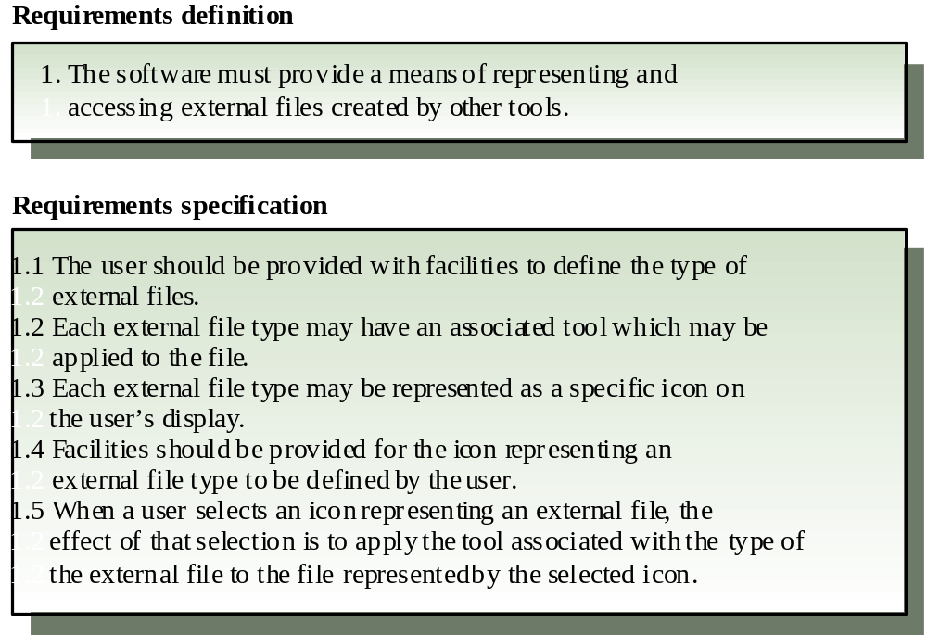
Definitions and specifications

Slide 6
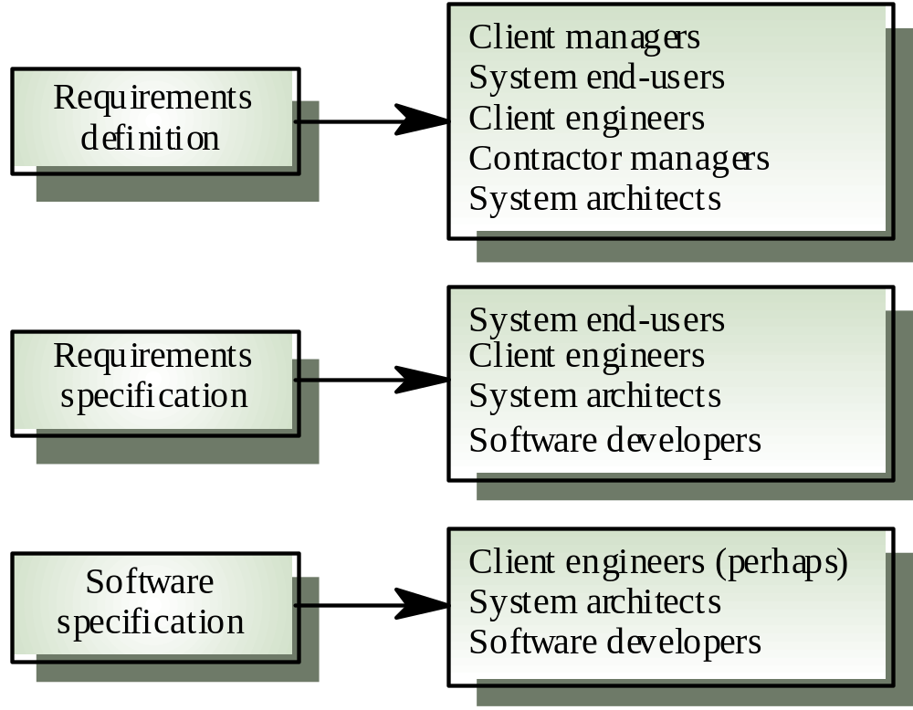
Requirements readers

Slide 7
Wicked problems
Most large software systems address wicked problems
Problems which are so complex that they can never be fully understood and where understanding evolves during the system development
Therefore, requirements are normally both incomplete and inconsistent

Slide 8
Reasons for inconsistency
Large software systems must improve the current situation. It is hard to anticipate the effects that the new system will have on the organisation
Different users have different requirements and priorities. There is a constantly shifting compromise in the requirements
System end-users and organisations who pay for the system have different requirements
Prototyping is often required to clarify requirements

Slide 9
The requirements engineering process
Feasibility study
  Find out if the current user needs be satisfied given the available technology and budget?
Requirements analysis
  Find out what system stakeholders require from the system
Requirements definition
  Define the requirements in a form understandable to the customer
Requirements specification
  Define the requirements in detail

Slide 10
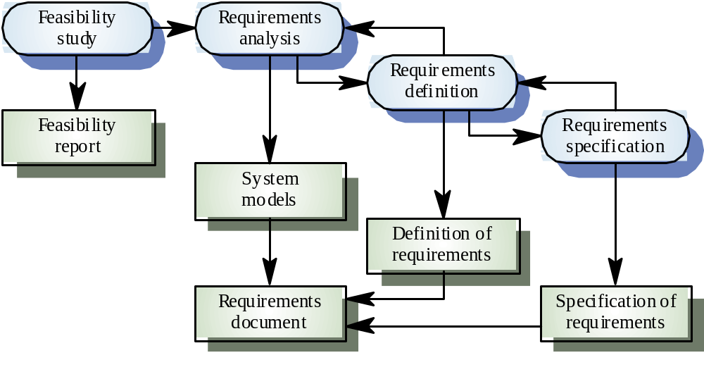
The RE process

Slide 11
The requirements document
The requirements document is the official statement of what is required of the system developers
Should include both a definition and a specification of requirements
It is NOT a design document. As far as possible, it should set of WHAT the system should do rather than HOW it should do it

Slide 12
Requirements document requirements
Specify external system behaviour
Specify implementation constraints
Easy to change
Serve as reference tool for maintenance
Record forethought about the life cycle of the system i.e. predict changes
Characterise responses to unexpected events

Slide 13
Requirements document structure
Introduction
  Describe need for the system and how it fits with business objectives
Glossary
  Define technical terms used
System models
  Define models showing system components and relationships
Functional requirements definition
  Describe the services to be provided

Slide 14
Requirements document structure
Non-functional requirements definition
  Define constraints on the system and the development process
System evolution
  Define fundamental assumptions on which the system is based and anticipated changes
Requirements specification
  Detailed specification of functional requirements
Appendices
  System hardware platform description
  Database requirements (as an ER model perhaps)
Index

Slide 15
Requirements validation
Concerned with demonstrating that the requirements define the system that the customer really wants
Requirements error costs are high so validation is very important
  Fixing a requirements error after delivery may cost up to 100 times the cost of fixing an implementation error
Prototyping is an important technique of requirements validation

Slide 16
Requirements checking
Validity. Does the system provide the functions which best support the customer’s needs?
Consistency. Are there any requirements conflicts?
Completeness. Are all functions required by the customer included?
Realism. Can the requirements be implemented given available budget and technology
Notes:
Why checking/validation of requirements?
Concerned with demonstrating that the requirements define the system that the customer really wants
Requirements error costs are high so validation is very important
Fixing a requirements error after delivery may cost up to 100 times the cost of fixing an implementation error
Prototyping (discussed in Chapter 8) is an important technique of requirements validation
Reviews
Regular reviews should be held while the requirements definition is being formulated
Both client and contractor staff should be involved in reviews
Reviews may be formal (with completed documents) or informal.
==> participative development, prototyping,
==> several abstraction levels of models, simple ones for customer
==> walkthroughs!!!! like with CRC-cards….

Slide 17
Requirements evolution
Requirements always evolve as a better understanding of user needs is developed and as the organisation’s objectives change
It is essential to plan for change in the requirements as the system is being developed and used

Slide 18
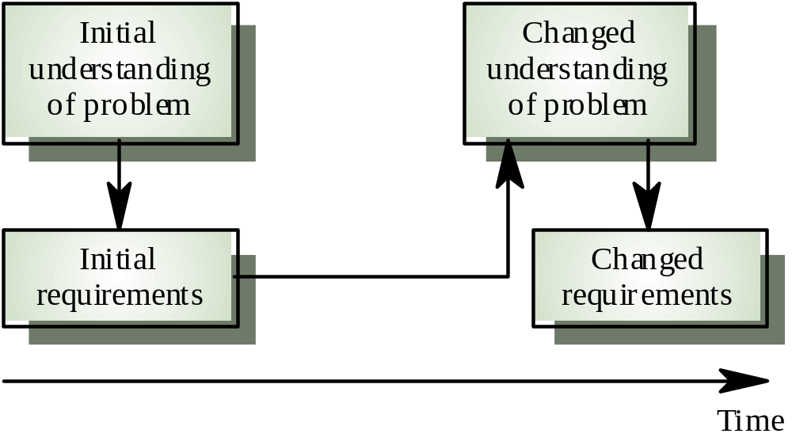
Requirements evolution

Slide 19
Requirements classes
Enduring requirements. Stable requirements derived from the core activity of the customer organisation. E.g. a hospital will always have doctors, nurses, etc. May be derived from domain models
Volatile requirements. Requirements which change during development or when the system is in use. In a hospital, requirements derived from health-care policy
Notes:
Tax-system:
- differentiate the requirements
- make design so volatile requirements do not need huge changes
- optimal: volatile requirements hidden behind changeable parameters, (e.g. preferences in tools, setup-panels)
==> special requirement for function that allows to change volatile requirements easily

Slide 20
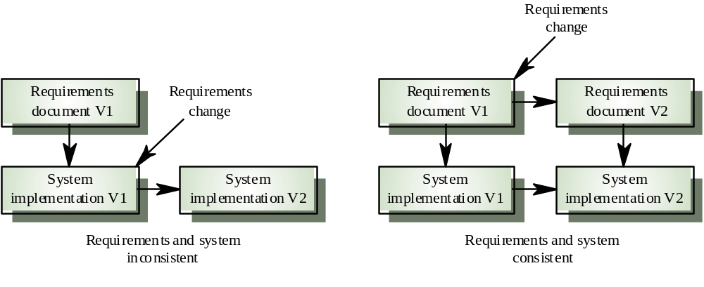
Controlled evolution
Notes:
Between releases

Slide 21
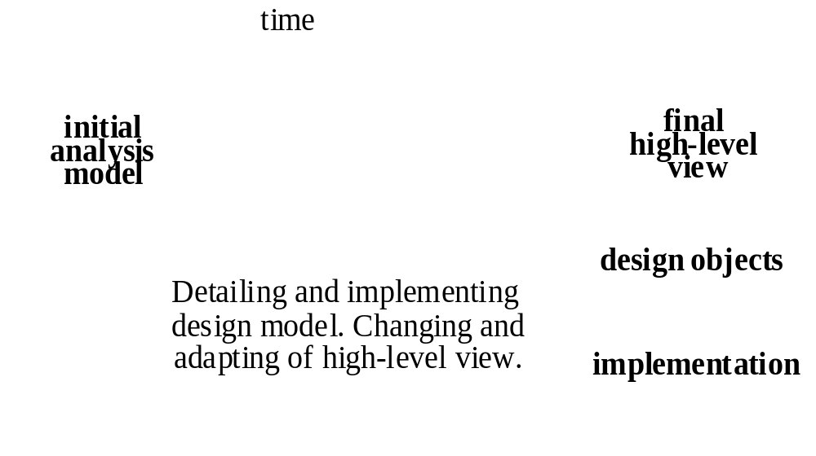
Model of requirements evolves (1)
requirements themselves change
our view / model of them changes
July 1998 Requirements Engineering
Notes:
Requirements change:
- inconsistencies
- impossibilities
- too expensive
- easier way to do it
- missing pieces
- changing environment: organisation, hardware infrasutructre, market, political laws,…
Our model changes:
- best set of use cases: never at first
- best structure of classes
- if you are lower in the model, you suddenly discover ideal structure for higher up

Slide 22
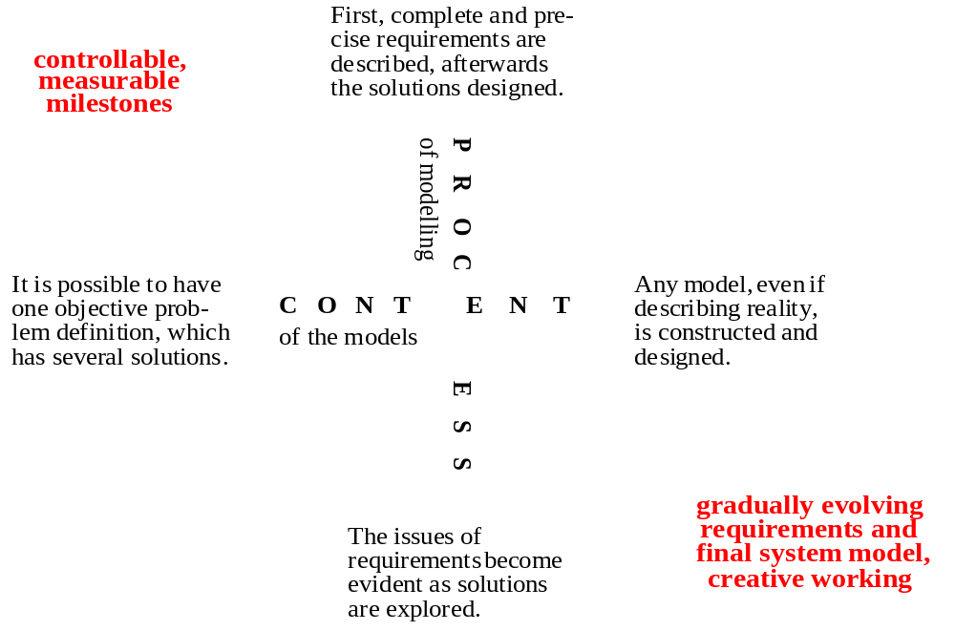
Model of requirements evolves (2)
July 1998 Requirements Engineering

Slide 23
Model of requirements evolves (3)
Idealistic approach (e.g. Fusion):
  The analysis model is stable after the analysis phase. It can be seamlessly extended into a design model.
  The initial analysis model is also the high-level view of the final system.
One-model approach (e.g. BON):
  The goal is one single model, maybe on several abstraction levels; no real separation between analysis and design.
  The model always undergoes changes and is never really stable.
  The initial analysis model is either discarded or changed into the final high-level view.
Two-model approach (e.g. MSA):
  Two separate models are made: an (initial) analysis model and a final high-level view of the system.
  These models are not identical; they may even use different notations. Links provide necessary traces.
July 1998 Requirements Engineering
Notes:
Two-model:
- analysis model: changing requirements are updated, not changing view of system

Slide 24
Key points
It is very difficult to formulate a complete and consistent requirements specification
A requirements definition, a requirements specification and a software specification are ways of specifying software for different types of reader
The requirements document is a description for customers and developers

Slide 25
Key points
Requirements errors are usually very expensive to correct after system delivery
Reviews involving client and contractor staff are used to validate the system requirements
Stable requirements are related to core activities of the customer for the software
Volatile requirements are dependent on the context of use of the system

Slide 26
End: Requirements Engineering
Establishing what the customer requires from a software system
what is it
Notes:
Objectives:
To introduce the notion of requirements engineering
To explain why requirements at different levels of detail are needed
To describe how the system requirements document may be organised
To describe the requirements validation process
To explain why requirements evolve during the lifetime of a system

Slide 27
Requirements Analysis
Understanding the customer’s requirements for a software system
how to do it
Notes:
To describe different approaches to requirements discovery
To explain the need for multi-perspective analysis
Modelling techniques
To explain why social and organisational factors influence system requirements

Slide 28
Requirements analysis
Sometimes called requirements elicitation or requirements discovery
Involves technical staff working with customers to find out about the application domain, the services that the system should provide and the system’s operational constraints
May involve end-users, managers, engineers involved in maintenance, domain experts, trade unions, etc. These are called stakeholders

Slide 29
Problems of requirements analysis
Stakeholders don’t know what they really want
Stakeholders express requirements in their own terms
Different stakeholders may have conflicting requirements
Organisational and political factors may influence the system requirements
The requirements change during the analysis process. New stakeholders may emerge

Slide 30
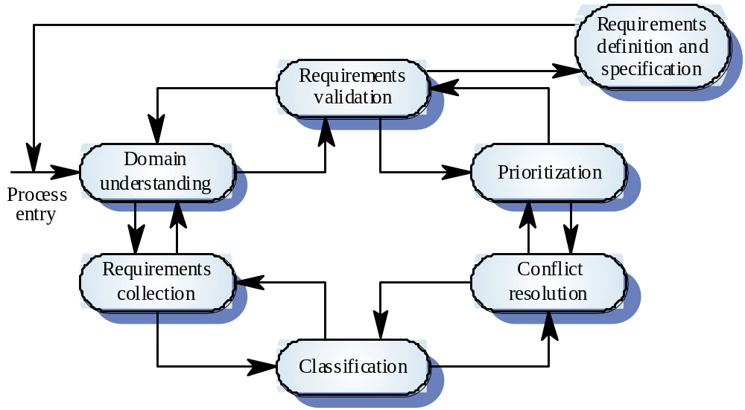
The requirements analysis process

Slide 31
System models
Different models may be produced during the requirements analysis activity
Requirements analysis may involve three structuring activities which result in these different models
  Partitioning. Identifies the structural (part-of) relationships between entities
  Abstraction. Identifies generalities among entities
  Projection. Identifies different ways of looking at a problem
Using modeling techniques, e.g. UML

Slide 32
Viewpoint-oriented analysis
Stakeholders represent different ways of looking at a problem or problem viewpoints
  different types of stakeholders
  different views among stakeholders of same type
This multi-perspective analysis is important as there is no single correct way to analyse system requirements

Slide 33
Autoteller system
The example used here is an auto-teller system which provides some automated banking services
I use a very simplified system which offers some services to customers of the bank who own the system and a narrower range of services to other customers
Services include cash withdrawal, message passing (send a message to request a service), ordering a statement and transferring funds

Slide 34
Autoteller viewpoints
Bank customers
Representatives of other banks
Hardware and software maintenance engineers
Marketing department
Bank managers and counter staff
Database administrators and security staff
Communications engineers
Personnel department

Slide 35
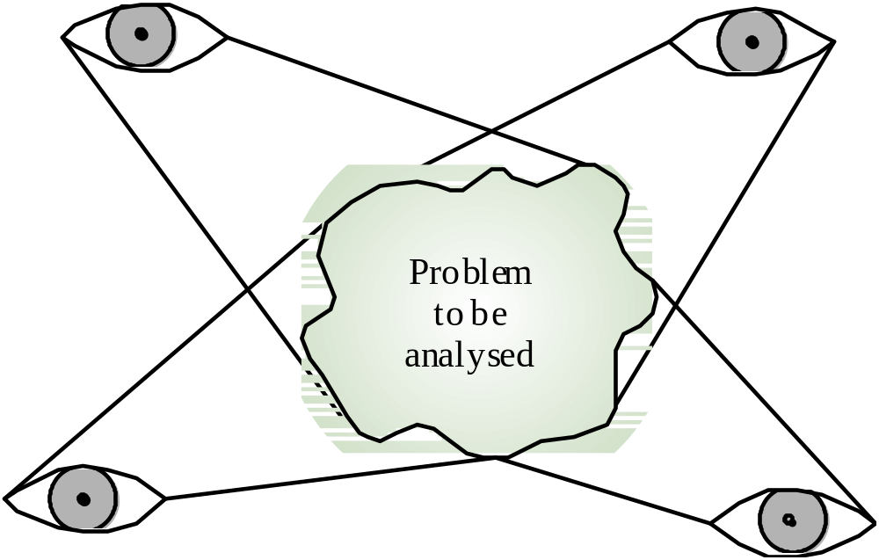
Multiple problem viewpoints

Slide 36
Types of viewpoint
Data sources or sinks
  Viewpoints are responsible for producing or consuming data. Analysis involves checking that data is produced and consumed and that assumptions about the source and sink of data are valid
Representation frameworks
  Viewpoints represent particular types of system models. These may be compared to discover requirements that would be missed using a single representation. Particularly suitable for real-time systems
Receivers of services
  Viewpoints are external to the system and receive services from it. Most suited to interactive systems

Slide 37
External viewpoints
Natural to think of end-users as receivers of system services
Viewpoints are a natural way to structure requirements elicitation
It is relatively easy to decide if a viewpoint is valid
Viewpoints and services may be sued to structure non-functional requirements

Slide 38
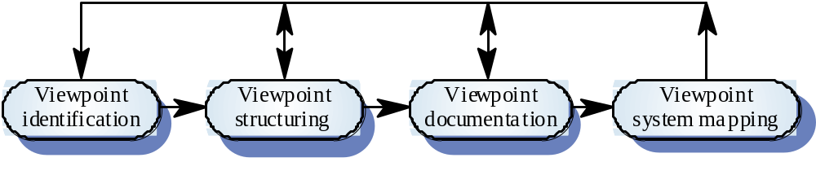
The VORD method
Notes:
Viewpoint identification
Discover viewpoints which receive system services and identify the services provided to each viewpoint
Viewpoint structuring
Group related viewpoints into a hierarchy. Common services are provided at higher-levels in the hierarchy
Viewpoint documentation
Refine the description of the identified viewpoints and services
Viewpoint-system mapping
Transform the analysis to an object-oriented design

Slide 39
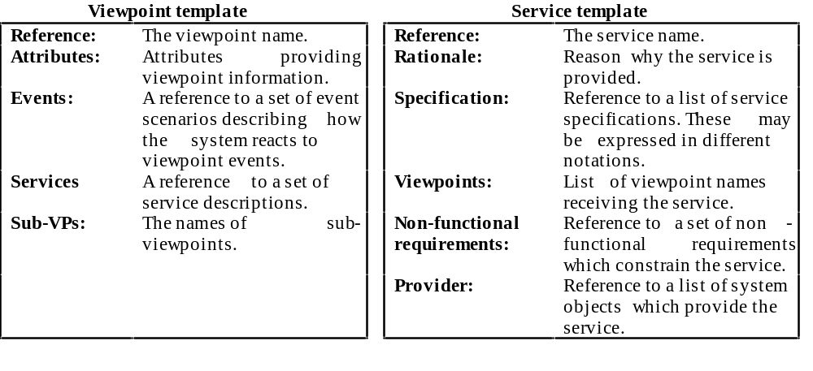
VORD standard forms

Slide 40
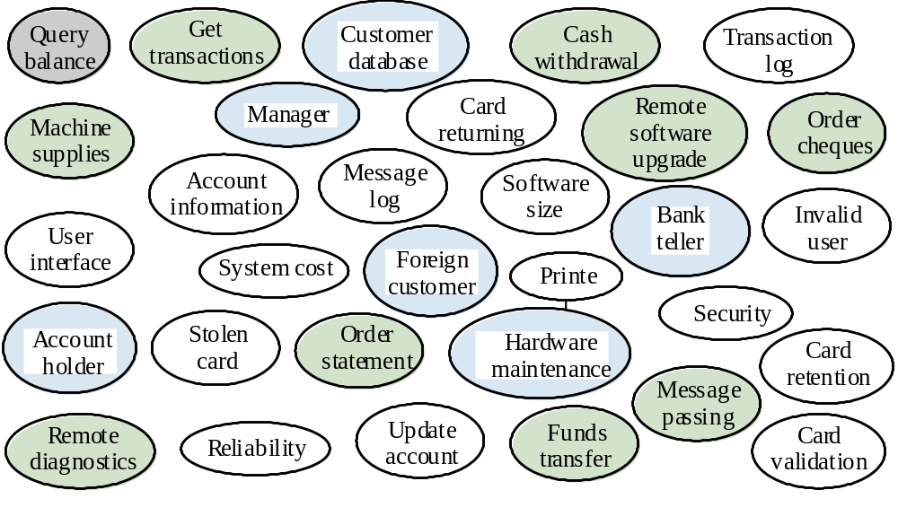
Viewpoint identification

Slide 41
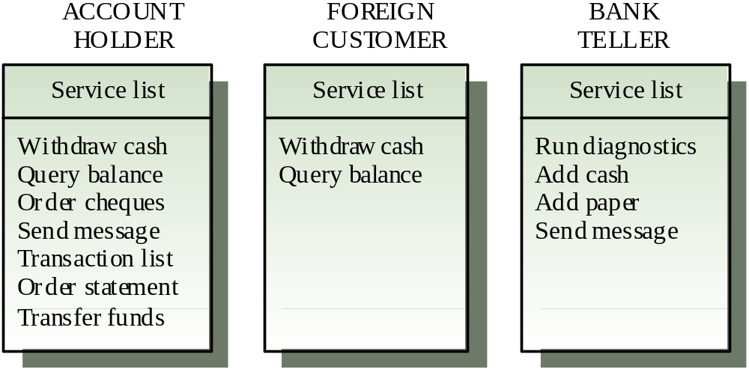
Viewpoint service information

Slide 42
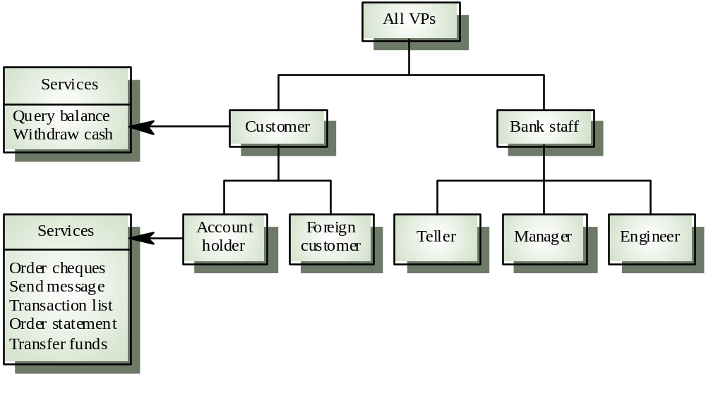
Viewpoint hierarchy

Slide 43
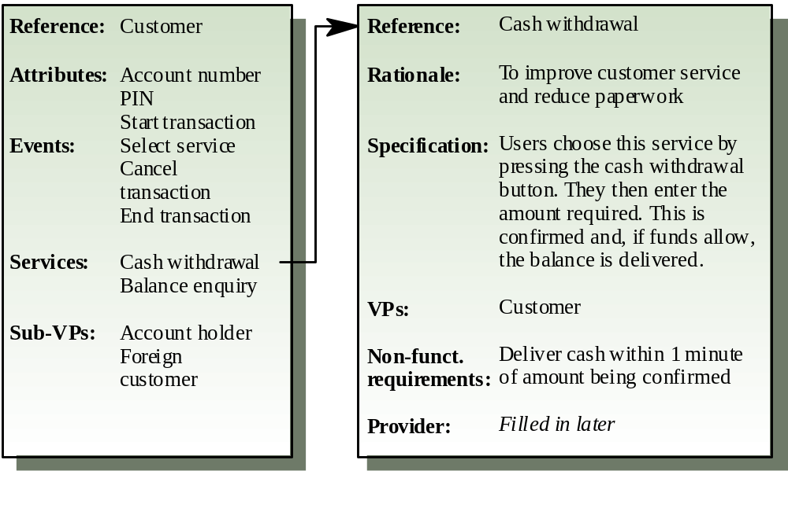
Customer/cash withdrawal templates

Slide 44
Method advantages/disadvantages
Methods impose structure on the requirements analysis process
May be supported by CASE tools
Can be applied systematically and can lead naturally to design
However, forces system modelling using a computational framework
Methods fail to adequately provide for the description of human activities

Slide 45
System contexts
The boundaries of the system must be established to determine what must be implemented
These are documented using a description of the system context. This should include a description of the other systems which are in the environment
Social and organisational factors may influence the positioning of the system boundary
Notes:
What to model?

Slide 46
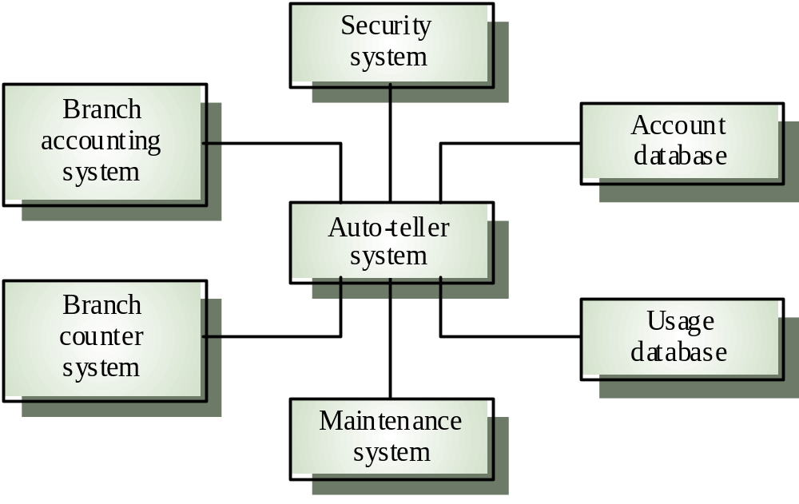
Auto-teller system context

Slide 47
Social and organisational factors
Software systems are used in a social and organisational context. This can influence or even dominate the system requirements
Social and organisational factors are not a single viewpoint but are influences on all viewpoints
Good analysts must be sensitive to these factors but currently no systematic way to tackle their analysis
Notes:
Example:
Consider a system which allows senior management to access information without going through middle managers
Managerial status. Senior managers may feel that they are too important to use a keyboard. This may limit the type of system interface used
Managerial responsibilities. Managers may have no uninterrupted time where they can learn to use the system
Organisational resistance. middle managers who will be made redundant may deliberately provide misleading or incomplete information so that the system will fail

Slide 48
Ethnographic analysis
A social scientists spends a considerable time observing and analysing how people actually work
People do not have to explain or articulate their work
Social and organisational factors of importance may be observed
Ethnographic studies have shown that work is usually richer and more complex than suggested by simple system models
Notes:
Or:
in order to understand what it is about, send systems engineers into work place!!!
Both:
- observing without questions
- observing with sessions of questions
Danger:
- certain procedures might be obsolete ==>
business analysis and reegineering

Slide 49
Key points
Requirements analysis requires domain understanding, requirements collection, classification, structuring, prioritisation and validation
Complex systems should be analysed from different viewpoints
Viewpoints may be based on sources and sinks of data, system models or external interaction

Slide 50
Key points
Structured methods may be used for requirements analysis. They should include a process model, system modelling notations, rules and guidelines for system modelling and standard reports
The VORD viewpoint-oriented method relies on viewpoints which are external to the system
The boundaries between a system and its environment must be defined
Social and organisational factors have a strong influence on system requirements

Slide 51
End: Requirements Analysis
Understanding the customer’s requirements for a software system
how to do it
Notes:
To describe different approaches to requirements discovery
To explain the need for multi-perspective analysis
Modelling techniques
To explain why social and organisational factors influence system requirements

Slide 52
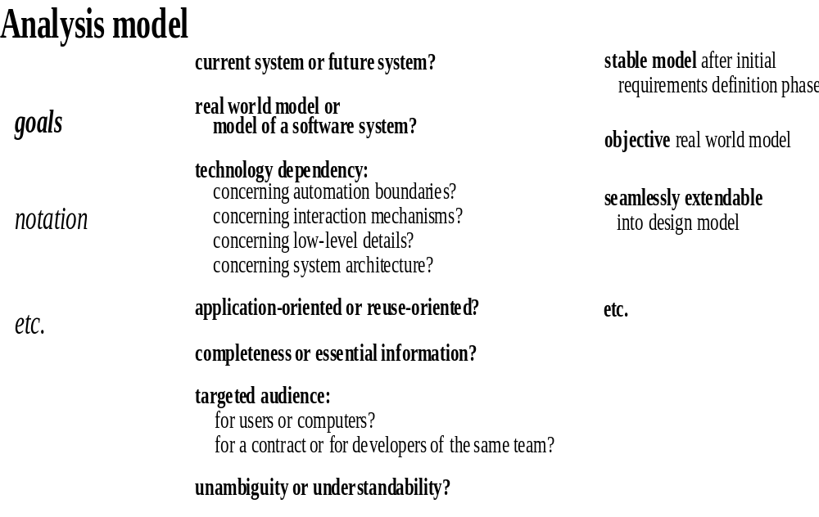
Analysis models in RE-documents
July 1998 Requirements Engineering
Notes:
Possible goals:
- real world model / model of a software system
- technology independent concerning automation boundaries / - interaction mechanisms / low-level details / system architecture
- complete / containing only essential information
- unambiguous (read by computers) / understandable (read by users)
- will be used as contract / will be used by the same development team
- stable after analysis phase
- seamlessly extendable into design model
Some of these goals are still very vague, some are mutually contradictory.

Slide 53
Software Prototyping for RE
Animating and demonstrating system requirements
  There are also other domains for prototyping!

Slide 54
Uses of system prototypes
The principal use is to help customers and developers understand the requirements for the system
The prototype may be used for user training before a final system is delivered
The prototype may be used for back-to-back testing

Slide 55
Prototyping benefits
Misunderstandings between software users and developers are exposed
Missing services may be detected
Confusing services may be identified
A working system is available early in the process
The prototype may serve as a basis for deriving a system specification

Slide 56
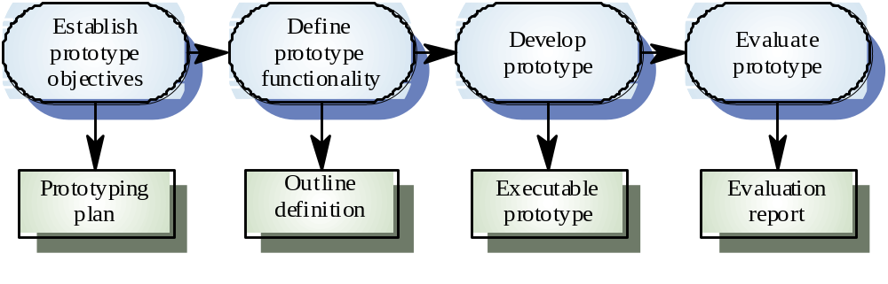
Prototyping process

Slide 57
Prototyping objectives
The objective of evolutionary prototyping is to deliver a working system to end-users. The development starts with those requirements which are best understood.
The objective of throw-away prototyping is to validate or derive the system requirements. The prototyping process starts with those requirements which are poorly understood

Slide 58
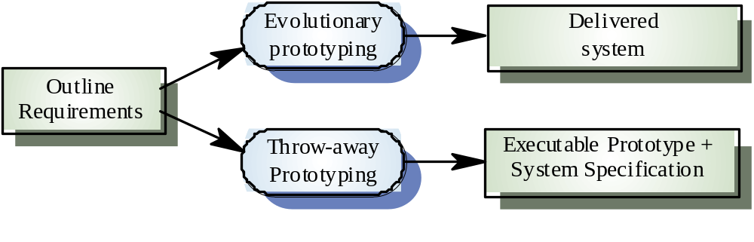
Approaches to prototyping

Slide 59
Evolutionary prototyping
Must be used for systems where the specification cannot be developed in advance e.g. AI systems and user interface systems
Based on techniques which allow rapid system iterations
Verification is impossible as there is no specification. Validation means demonstrating the adequacy of the system

Slide 60
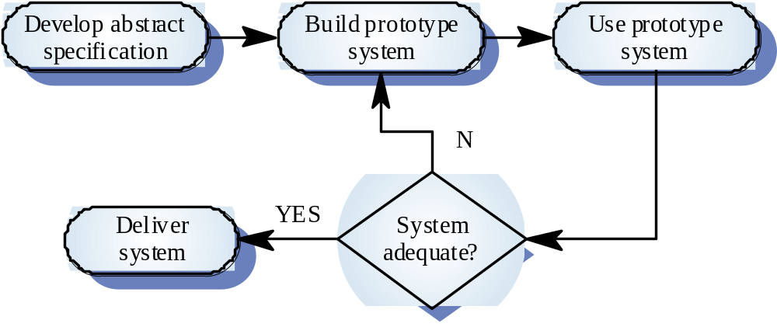
Evolutionary prototyping

Slide 61
Evolutionary Prototyping
Problems?
Dangers?
July 1998 Requirements Engineering
Notes:
-Prototyping forever
- never good quality
- always hacking
- changing target
- always throwing out old stuff
Where evolutionary prototyping?
- trying out new ideas
- unknown requirements
- systems used by those building them - no deployment (e.g. high-energy physics - NOT everything there)

Slide 62
Evol. prototyping problems
Existing management processes assume a waterfall model of development
Continual change tends to corrupt system structure so long-term maintenance is expensive
Specialist skills are required which may not be available in all development teams
Organisations must accept that the lifetime of systems developed this way will inevitably be short

Slide 63
Throw-away prototyping
Used to reduce requirements risk
The prototype is developed from an initial specification, delivered for experiment then discarded
The throw-away prototype should NOT be considered as a final system
  Some system characteristics may have been left out - shortcuts
  There is no specification for long-term maintenance
  The system will be poorly structured and difficult to maintain

Slide 64
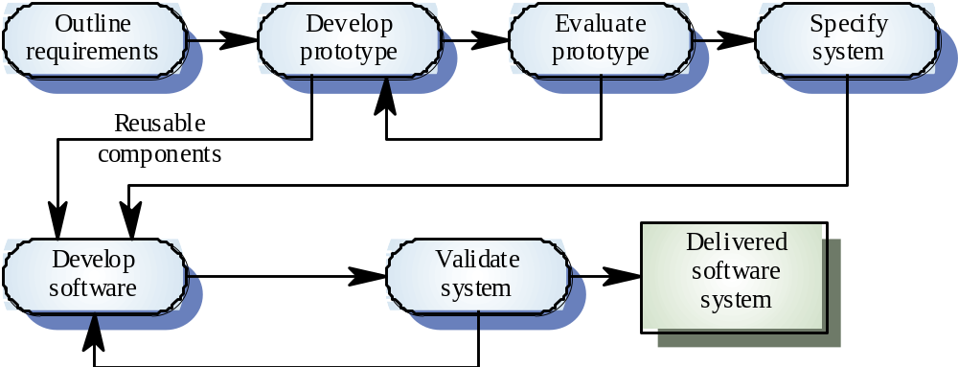
Throw-away prototyping

Slide 65
Throw-away Prototyping
Problems?
Dangers?
July 1998 Requirements Engineering
Notes:
-Meant to be thrown away yet:
- no time left
- user just wants that
- yet: hacked!!!!
- false impression of progress
==> real software quality is not seen on the surface (e.g. never ever destroyed a file on NextStep, much less crashes)

Slide 66
Prototypes as specifications
Some parts of the requirements (e.g. safety-critical functions) may be impossible to prototype and so don’t appear in the specification
An implementation has no legal standing as a contract
Non-functional requirements cannot be adequately tested in a system prototype
System model is hidden - and gets lost

Slide 67
Incremental development
System is developed and delivered in increments after establishing an overall architecture
Users may experiment with delivered increments while others are being developed. therefore, these serve as a form of prototype system
Intended to combine some of the advantages of prototyping but with a more manageable process and better system structure

Slide 68
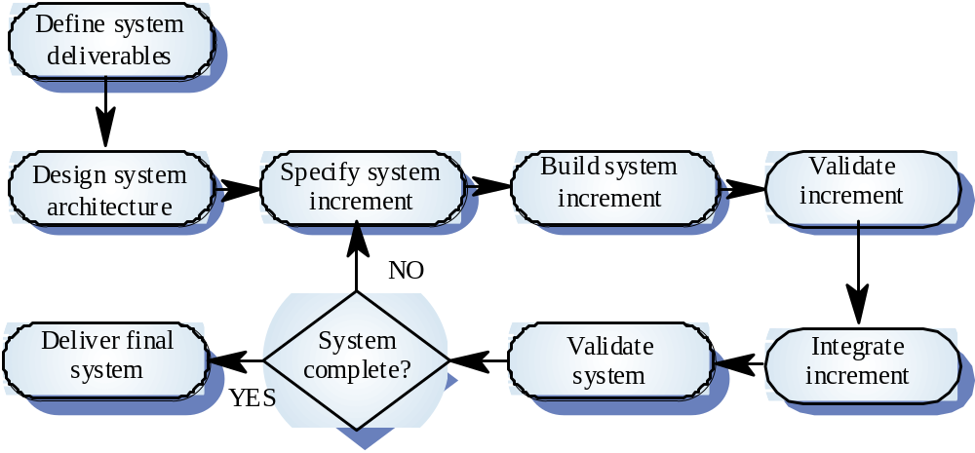
Incremental development process

Slide 69
Incremental Prototyping
Problems?
Dangers?
July 1998 Requirements Engineering
Notes:
Increments:
- easy stuff first ==> only after difficult stuff has been prototyped by throw-away prototypes!!!
- requires clear architecture
- false progress
Yet: the way to go !!!

Slide 70
Prototyping techniques
Executable specification languages
Very high-level languages
Application generators and 4GLs
Composition of reusable components
Notes:
Executable specification language
The system is specified in a formal language
This specification is processed and an executable system is automatically generated
At the end of the process, the specification may serve as a basis for a re-implementation of the system
YET: following problems:
Graphical user interfaces cannot be prototyped
Formal specification development is not a rapid process
The executable system is usually slow and inefficient
Executable specifications only allow functional requirements to be prototyped
Smalltalk
Very powerful system for prototyping interactive systems
Object-oriented language so systems are resilient to change
The Smalltalk environment objects are available to the prototype developer
The system incldues support software such as graphical user interface generation tools
4GL
Domain specific languages for business systems based around a database management system
Normally include a database query language, a screen generator,
a report generator and a spreadsheet
May be integrated with a CASE toolset
Cost-effective for small to medium sized business systems
Components: VisualBasic, Java, Scripting, Shells, ==> good libraries

Slide 71
User interface prototyping
It is impossible to pre-specify the look and feel of a user interface in an effective way. prototyping is essential
UI development consumes an increasing part of overall system development costs
Prototyping may use very high level languages such as Smalltalk or Java, or UIMS's
User interface generators may be used to ‘draw’ the interface and simulate its functionality

Slide 72
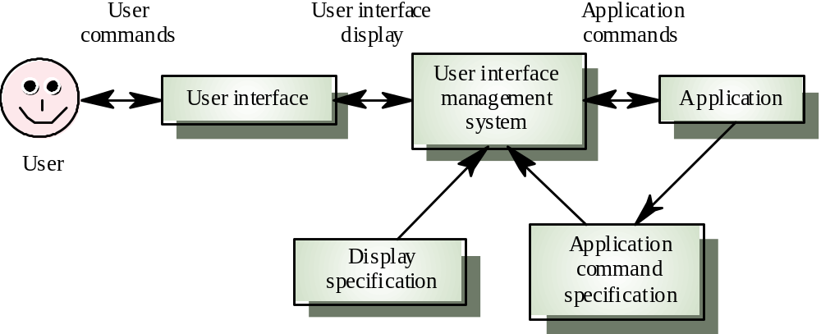
User interface management system

Slide 73
Key points
A prototype can be used to give end-users a concrete impression of the system’s capabilities
Prototyping may be evolutionary prototyping or throw-away prototyping; special case of incremental development
Rapid development is essential for prototype systems
Prototype structures become corrupted by constant change. Hence, long-term evolution is difficult

Slide 74
Key points
In a throw-away prototype start with the least well-understood parts; in an evolutionary prototype, start with the best understood parts
Prototyping methods include the use of executable specification languages, very high-level languages, fourth-generation languages and prototype construction from reusable components
Prototyping is essential for parts of the system such as the user interface which cannot be effectively pre-specified

Slide 75
Template
First header
1st paragraph, text
  SEI Process Maturity Model
    IEEE standards, e.g. requirements
    document,
      ISO standards, e.g. ISO 9000 - 9001
July 1998 Requirements Engineering

